Slide 1

Implement Raibert-control of a 3D Hopper in Pybullet
Hang Gao, Wenran Tian
MAE-207

Slide 2
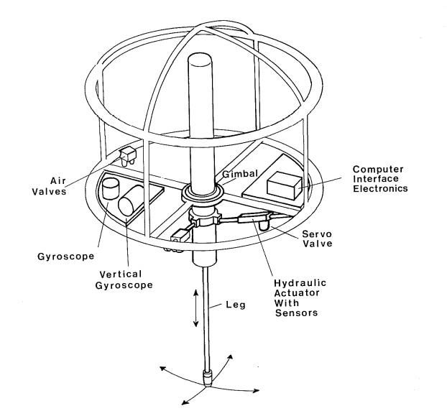
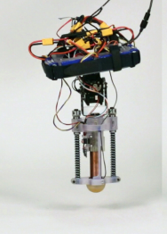
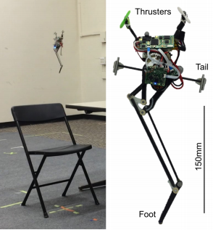
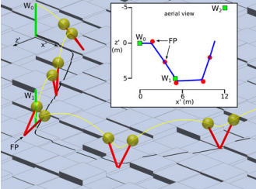
Overview of one leg hopper
Raibert, M. H. 1986. Legged Robots That Balance. Cambridge, MA: MIT Press.
Batts, Zachary et al. “Untethered One-Legged Hopping in 3D Using Linear Elastic Actuator in Parallel (LEAP).” ISER (2016).
Yim, Justin K. and R. Fearing. “Precision Jumping Limits from Flight-phase Control in Salto-1P.” 2018 IEEE/RSJ International Conference on Intelligent Robots and Systems (IROS) (2018): 2229-2236
A. Wu and H. Geyer, "The 3-D Spring–Mass Model Reveals a Time-Based Deadbeat Control for Highly Robust Running and Steering in Uncertain Environments," in IEEE Transactions on Robotics, vol. 29, no. 5, pp. 1114-1124, Oct. 2013, doi: 10.1109/TRO.2013.2263718

Slide 3
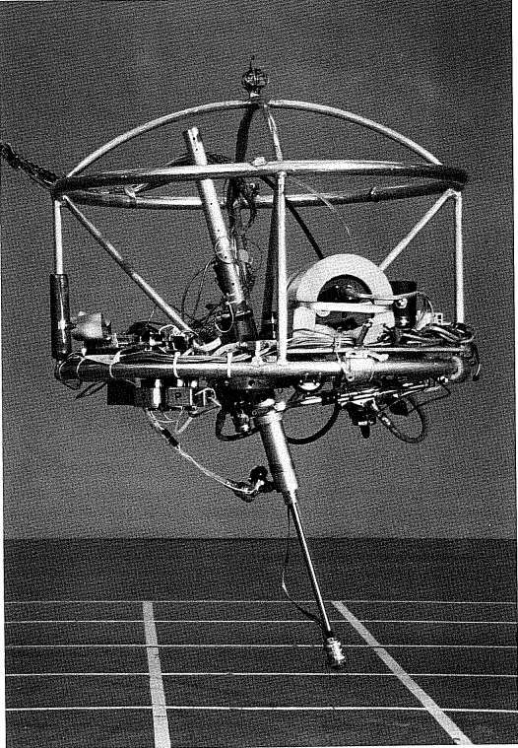
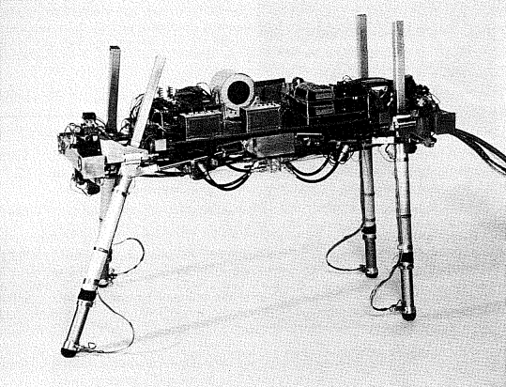
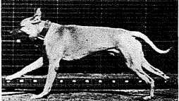

Slide 4
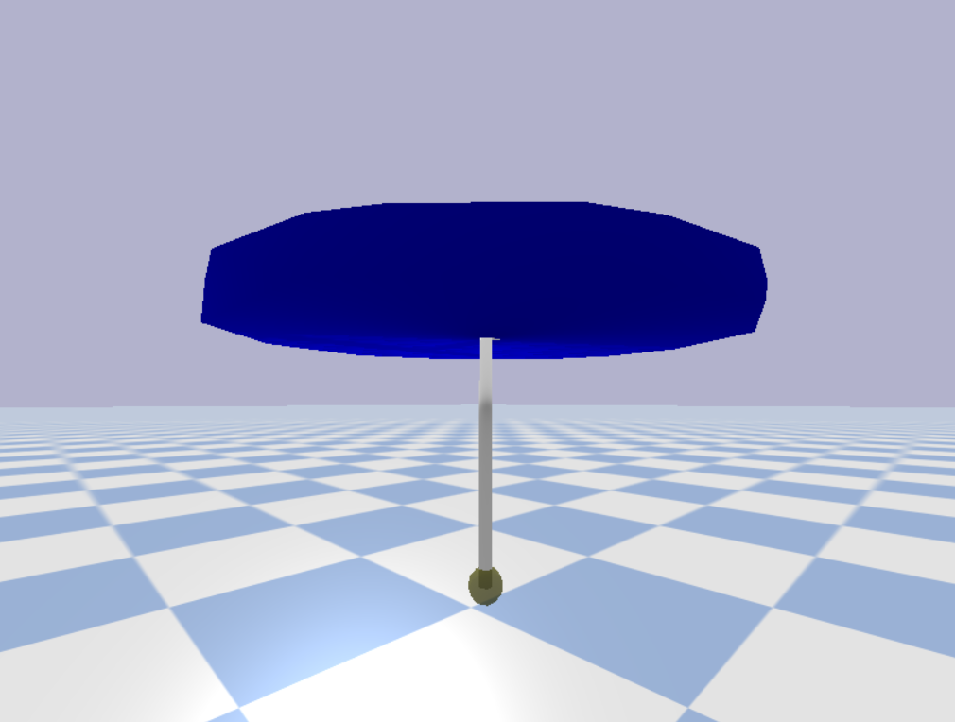
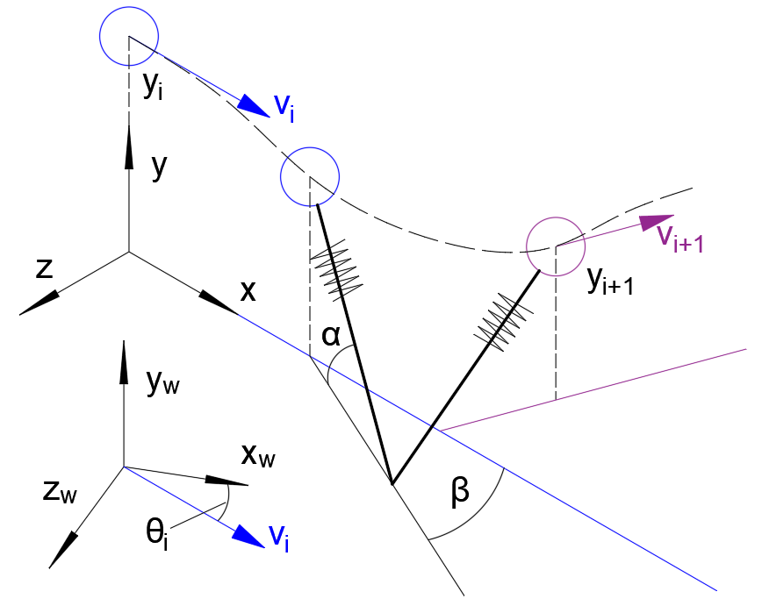

Yaw
mass disk
Roll
Pitch
Roll hip
Pitch hip
$90°−α$ = pitch;
$β$ = roll
Spring leg
Foot tip

Slide 5
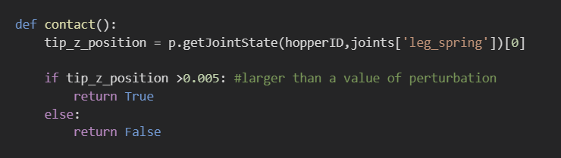
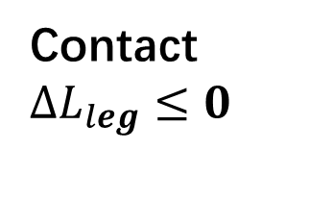
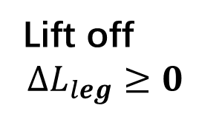
Flight
Lift off
$$ΔL_{leg}≥0$$
Contact $ΔL_{leg}≤0$
Thrust
Compression

Slide 6
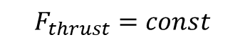

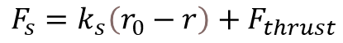
Forward speed control
Hopping height control
Body attitude control
$$x_{f}=\frac{\dot{x}T_{s}}{2}+k_{\dot{v}}(\dot{x}−{\dot{x}}_{d})$$
$τ=−(−k_{p}\left(θ−θ_{d}\right)−k_{ν}\dot{θ}$)
$$F_{s}=k_{s}\left(r_{0}−r\right)+F_{thrust}$$
$$τ=−k_{p}\left(γ−γ_{d}\right)−k_{ν}\dot{γ}$$
$τ= (−k_{p}\left(θ−θ_{d}\right)−k_{ν}\dot{θ}$)
$$F_{thrust}=const$$

Slide 7
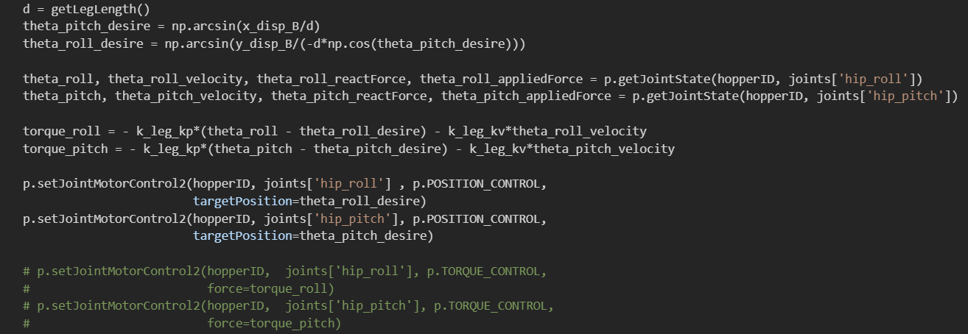

Forward speed control
$$x_{f}=\frac{\dot{x}T_{s}}{2}+k_{\dot{v}}(\dot{x}−{\dot{x}}_{d})$$
$$τ=−k_{p}\left(γ−γ_{d}\right)−k_{ν}\dot{γ}$$

Slide 8
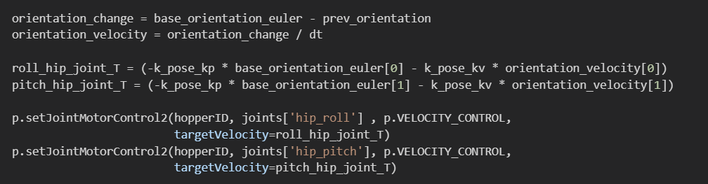
Hopping height control
$τ=−(−k_{p}\left(θ−θ_{d}\right)−k_{ν}\dot{θ}$)
$τ= (−k_{p}\left(θ−θ_{d}\right)−k_{ν}\dot{θ}$)

Slide 9
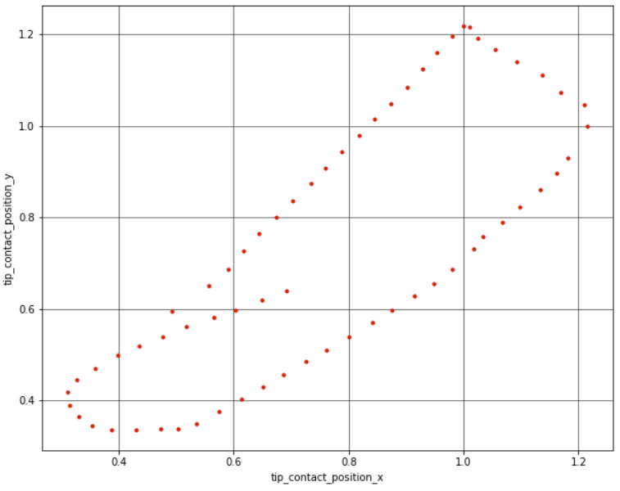

Slide 10
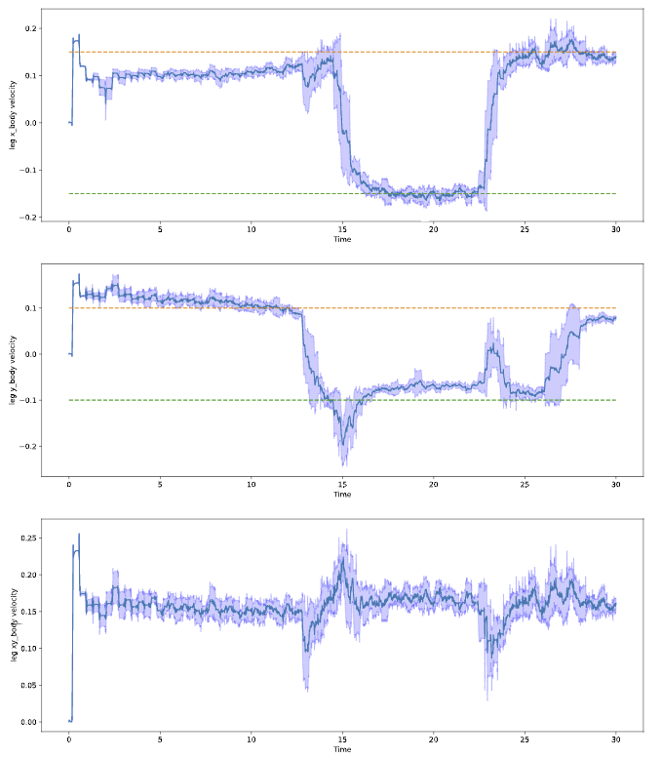

Slide 11
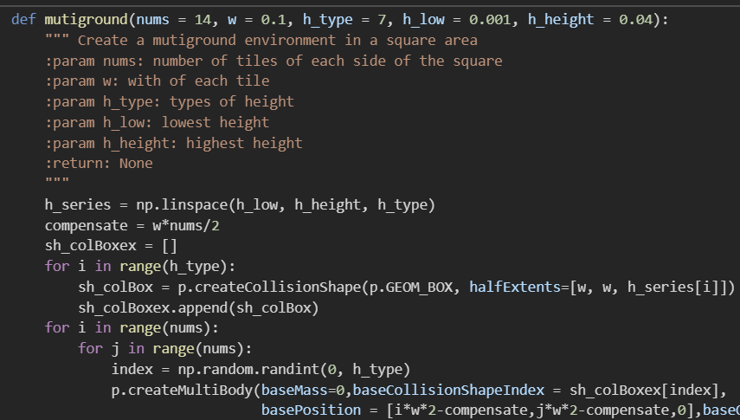
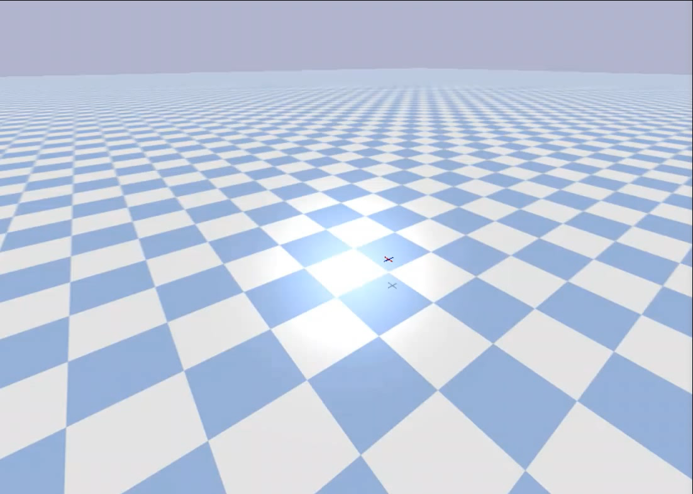
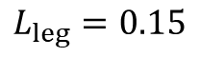
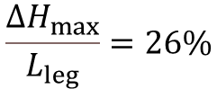
$$ΔH_{max}=0.04−0.001=0.039$$
$$L_{leg}=0.15$$
$$\frac{ΔH_{max}}{L_{leg}}=26\%$$

Slide 12
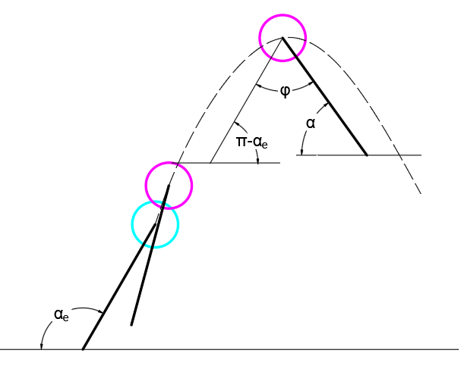
Hopper in 2D Environment

Slide 13
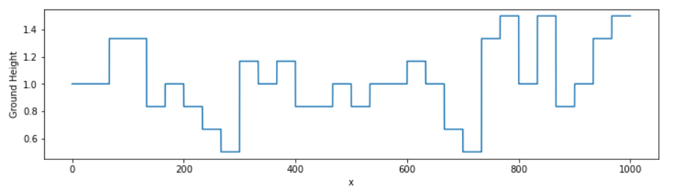
Random height uneven ground

Slide 14
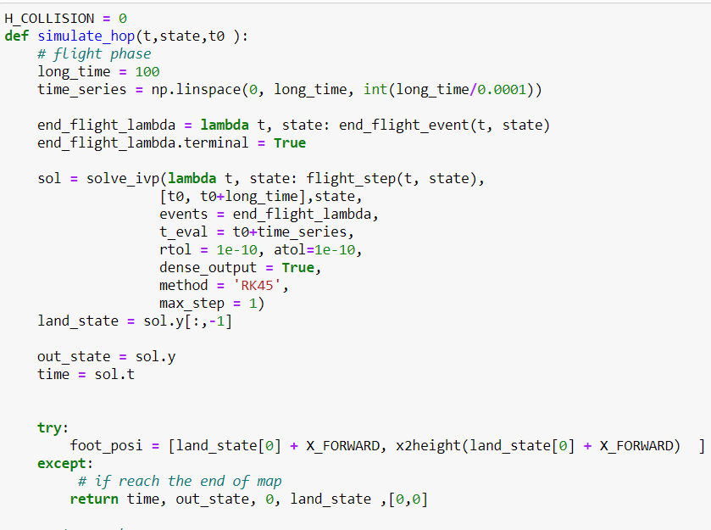
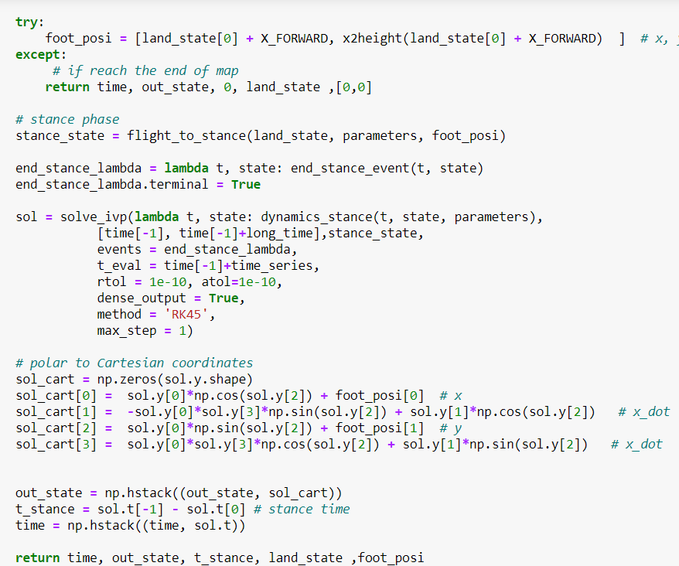
Simulation

Slide 15
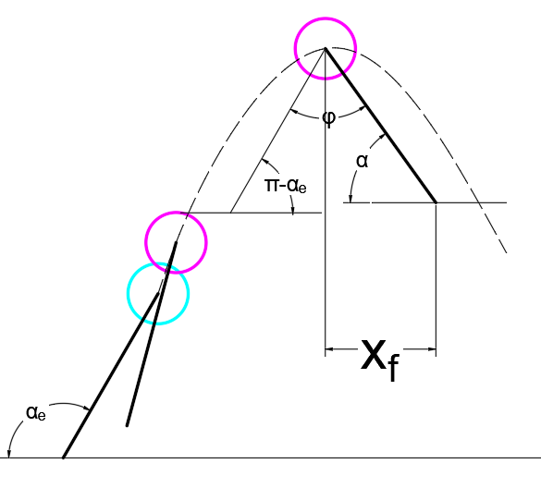
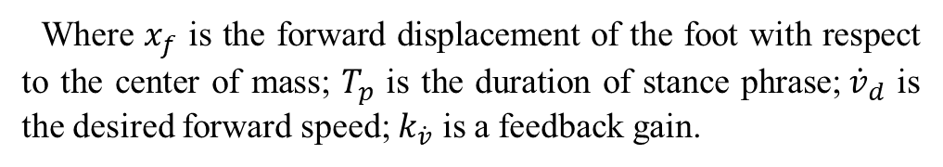
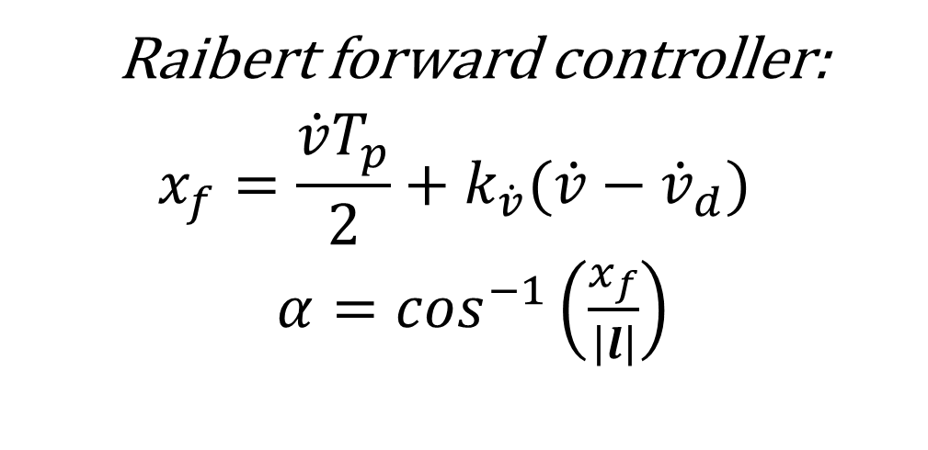
2D Controller
Raibert forward controller:
$$x_{f}=\frac{\dot{v}T_{p}}{2}+k_{\dot{v}}(\dot{v}−{\dot{v}}_{d})$$
$α=\cos^{−1}\left(\frac{x_{f}}{\left|l\right|}\right)$
Where $x_{f}$ is the forward displacement of the foot with respect to the center of mass; $T_{p}$ is the duration of stance phrase;${\dot{v}}_{d}$ is the desired forward speed; $k_{\dot{v}}$ is a feedback gain.

Slide 16
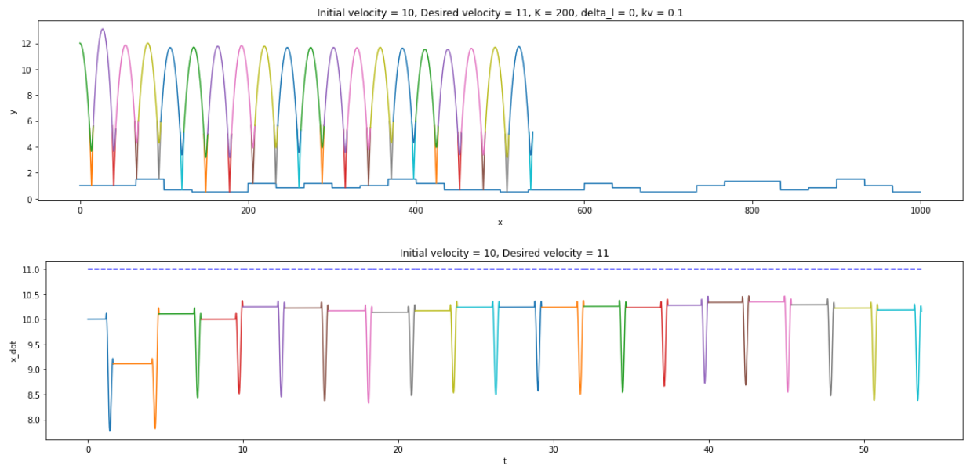
It is concise, it is stable, but……
steady state error ！

Slide 17
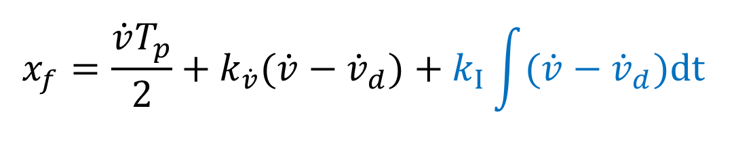
To compensate the steady state error, the integral term was introduced to controller
$$x_{f}=\frac{\dot{v}T_{p}}{2}+k_{\dot{v}}(\dot{v}−{\dot{v}}_{d})+k_{I}\int{(\dot{v}−{\dot{v}}_{d})dt}$$
The controller is now pretty much like the classical PID controller

Slide 18
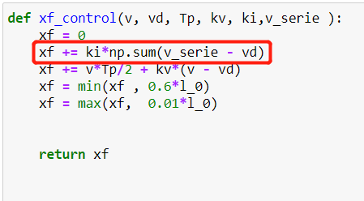
Implementation in program
1. Maintain a queue to save the velocity history
2. Choose a proper length of queue (3 in 2D hopper)
3. Adjust the value of ki

Slide 19
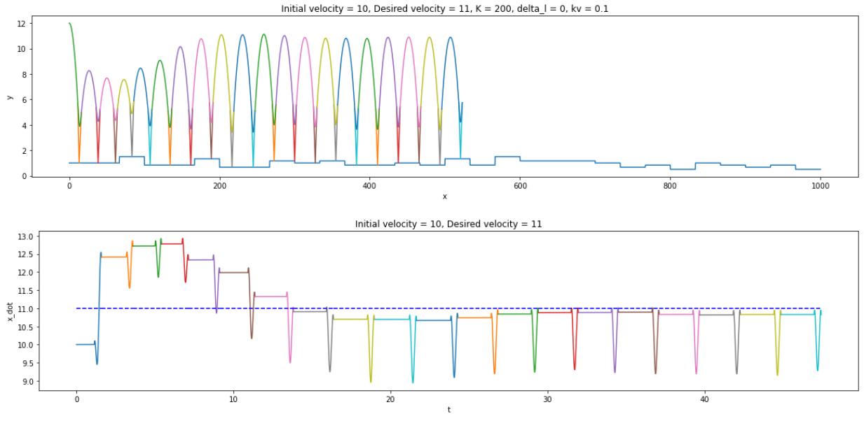
Reasonable result:

Slide 20
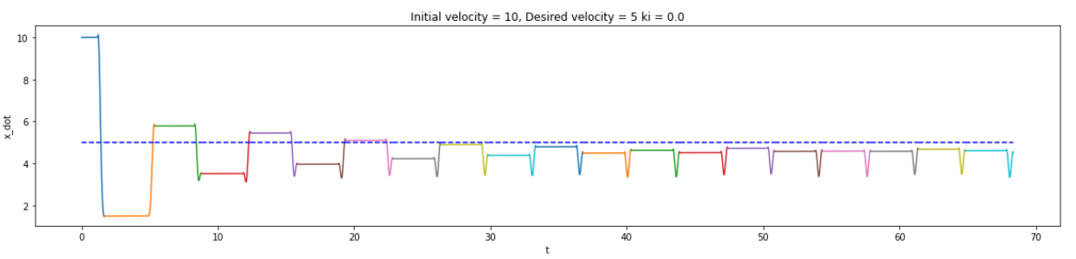
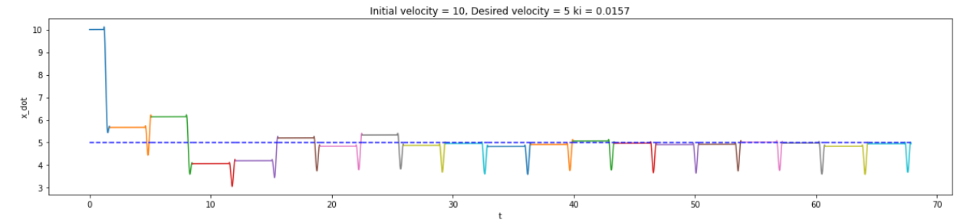

Slide 21
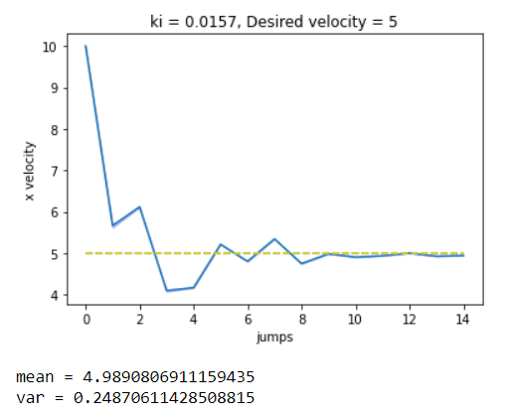
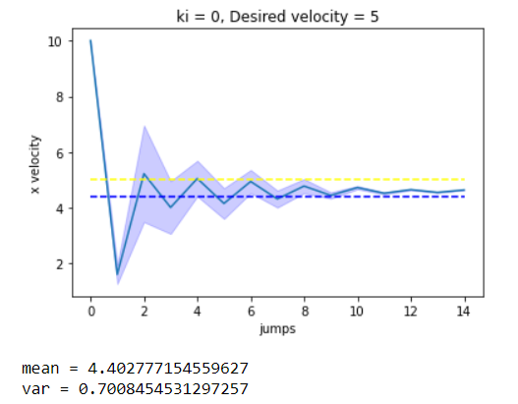
Iteration 6 times, and jumping 15 times each iteration, initial velocity = 10, desired velocity = 5

Slide 22
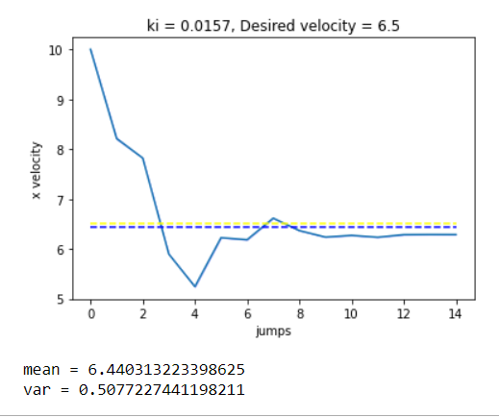
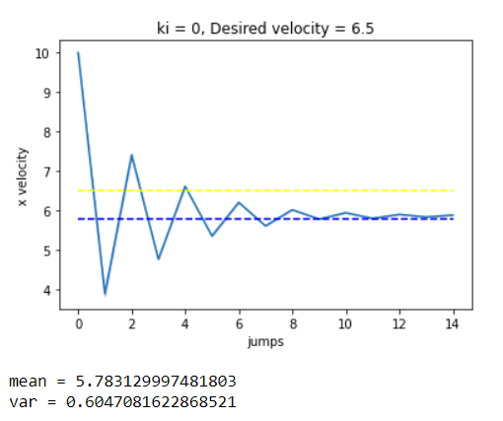
Iteration 6 times, and jumping 15 times each iteration, initial velocity = 10, desired velocity = 6.5

Slide 23
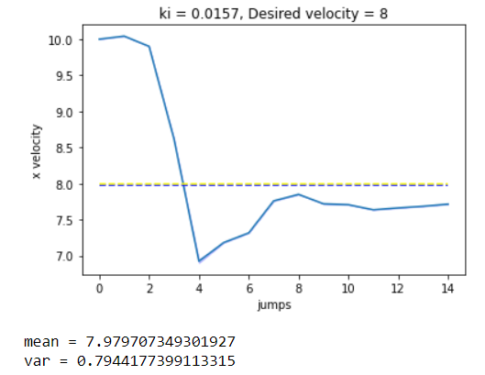
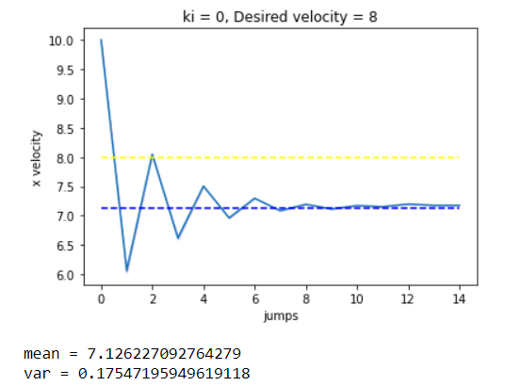
Iteration 6 times, and jumping 15 times each iteration, initial velocity = 10, desired velocity = 8

Slide 24
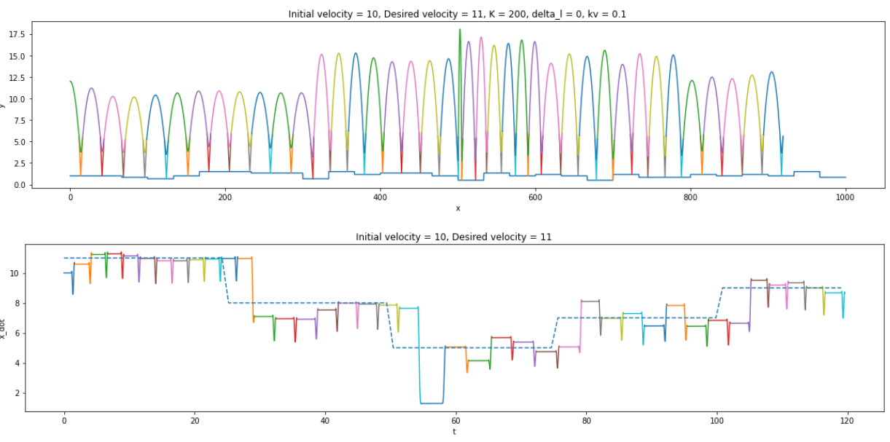
Time-velocity track

Slide 25
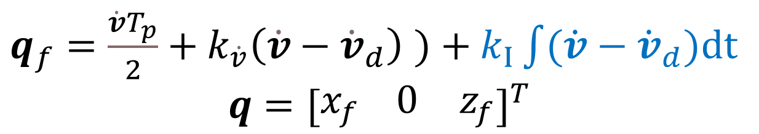
So we will also introduce the integral term to 3D hopper controller
$q_{f}=\frac{\dot{v}T_{p}}{2}+k_{\dot{v}}\left(\dot{v}−{\dot{v}}_{d}\right)$ $)+k_{I}\int{(\dot{v}−{\dot{v}}_{d})dt}$
$$q={[\begin{matrix}x_{f} 0 & z_{f}\end{matrix}]}^{T}$$

Slide 26
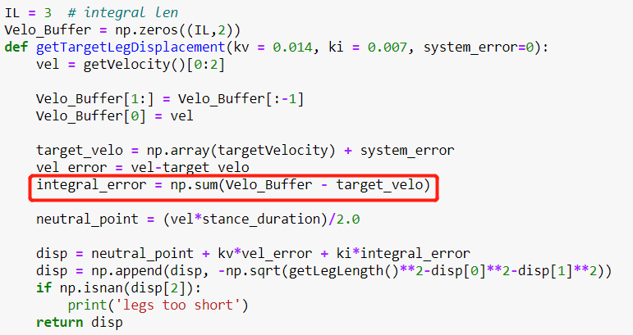
Implementation in program
1. Maintain a queue to save the velocity history
2. Choose a proper length of queue (3 in 2D hopper)
3. Adjust the value of ki

Slide 27
$$ΔH_{max}=0.04−0.001=0.039$$
$$L_{leg}=0.15$$
$$\frac{ΔH_{max}}{L_{leg}}=26\%$$

Slide 28
Thanks you all !

